Slide 1





HOW TO PAY LESS TAXES
*LEGALLY
created by team “Break”

Slide 2


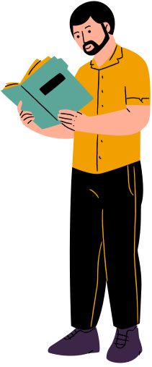

MONEY$PARTA
1
Tax Management
2
Financial Assistence
3
Money guidance

Slide 3
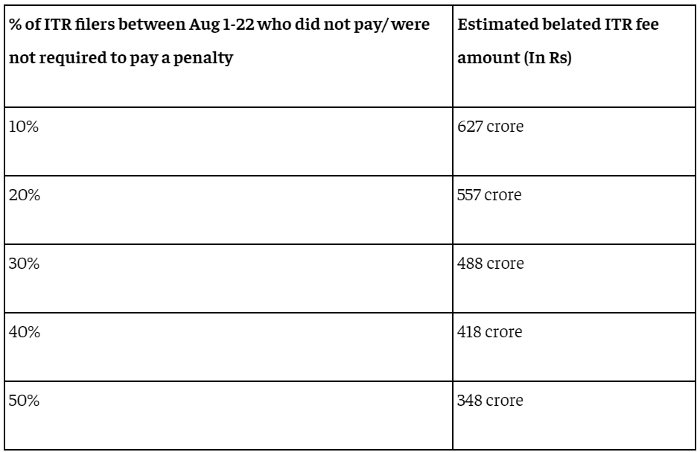
Problem
Statement
"Navigating the complex landscape of tax
filing in India can be overwhelming for
individuals and small businesses. With multiple tax slabs, frequent regulatory changes, and intricate filing requirements, taxpayers often face confusion, errors, and missed deadlines, leading to penalties and financial stress.
In india rougly 400 crores in rupees goest to the government in form of late fees because of people not having an idea about the timings and not only that only 2.2% of indians pay taxes. (refrence: The Economic Times , ICICI Direct)

Slide 4

Solution
We are excited to introduce our new website Money$sparta, designed specifically to address and simplify India’s complex tax landscape.Money$parta one-stop solution for all tax-related issues in India. Here’s how we make it easier
1
Clear Tax Guides: We provide easy-to-understand information on various taxes like income tax and GST.
2
Quick Calculations: Automated tools help you calculate your taxes accurately.
3
Easy Filing: Our streamlined process simplifies filing taxes, saving you time and effort.

Slide 5
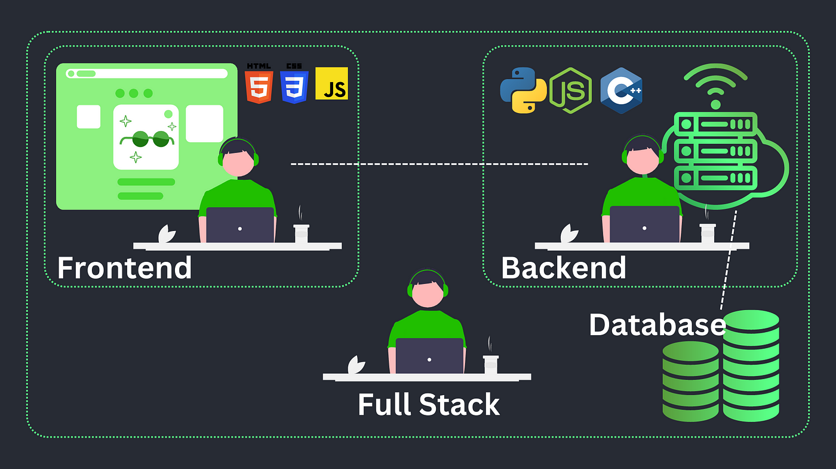
Technical Approach

Slide 6

Technical Approach
Our technical approach towards frontend will be done with a strong and user friendly GUI , which will be made using the following tool :-
HTML/CSS: For structuring and styling the website's pages.
JavaScript: For interactive elements on the website, such as forms, dynamic content updates, and client-side validation.
Frontend Frameworks/Libraries:
React.js: To create a dynamic and responsive user interface.
Further the backend will be held on these pillars
Python for server-side logic and handling HTTP requests, MySQL
for storing structured data (user profiles, tax records, payment history)
RESTful APIs or GraphQL for communication between the frontend and backend.
.

Slide 7

Technical Approach
UI/UX Design(Figma)
Design intuitive, user-friendly interfaces with clear navigation to help users easily find and use the services they need.
Regulatory Compliance -
Ensure the website complies with local tax laws and regulations.
Data Management and Security
Encrypt sensitive data, validate user-submitted information, and perform regular backups to ensure data integrity, security, and recovery.
Data Validation: To ensure the integrity and security of user-submitted data. - RegularBackups: For data safety and recovery in case of a system failure.

Slide 8

Target audience
1
Individual Taxpayers: Salaried employees, self-employed professionals, investors, retirees, and pensioners needing help with tax filing, deductions, and planning.
Business Owners and Entrepreneurs: SMEs, startups, and larger corporate entities requiring assistance with tax compliance, GST, payroll, and corporate tax planning.
Tax Professionals and Financial Advisors: CAs, tax advisors, and financial planners use the platform to manage client needs and stay updated on tax laws.
New Taxpayers and First-Time Filers: Young professionals and recent graduates learning to file taxes for the first time.
Compliance-Conscious Users: Individuals and businesses focused on maintaining tax compliance and simplifying their tax management.
Educational Institutions and Students: Schools, colleges, and students learning about Indian taxation.

Slide 9


Impact of Money$parta
Simplifies Tax Management: Offers a streamlined, user-friendly process for tax filing that reduces the complexity and risk of errors. This helps both individuals and businesses handle their taxes more efficiently.
Saves Time and Money: Provides automated tools for quick tax calculations and filing, eliminating the need for lengthy manual processes and reducing costs associated with hiring tax professionals.
Enhances Compliance and Security: Ensures users adhere to current tax regulations while safeguarding their personal and financial data with robust security measures, preventing legal issues and data breaches.
Improves Financial Literacy: Offers easy-to-understand guides and access to experts, empowering users to make well-informed decisions about tax planning and financial management.

Slide 10
Feasibility
1. Ease of Use: Money$parta offers a user-friendly interface with step-by-step guidance, making it accessible for most people, even those with limited tax knowledge.
2. Convenience: The software allows for easy e-filing from home, retains past user information, and is updated regularly to comply with the latest tax laws.
3. Support Options: It provides various support levels, including online resources and access to tax experts for additional fees, making it versatile for different user needs.
Scalability
1. Technology Infrastructure: It needs a robust, scalable infrastructure to handle increased users, especially during peak times, without performance issues.
2. Feature Expansion: Money$parta should be capable of adding new features and services to cater to a diverse user base, including individuals and businesses with varying tax needs.
3. Customer Support: Effective scalability requires expanding customer support to handle more users, including enhancing automated and human support resources.

Slide 11

